Slide 1

COOPERATIVE FINANCIAL INSTITUTION AND COOPERATIVE BANK MEMBER SURVEY

Slide 2
Contents
1)Executive Summary
2)Objectives
3)Methodology
4)Member demographics
5)Survey analysis top themes
Defining a CFI/Cooperative Bank
Perceptions of CFI/Cooperative bank
Value proposition
Challenges and opportunities for loans and savings
Other challenges and issues
Opportunities for CFI/Cooperative banks
Role of the CBDA
Complaints procedure

Slide 3
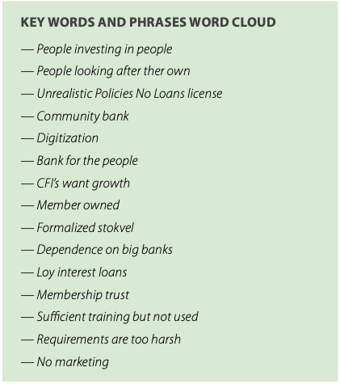
Executive summary
General feedback and participation
General views of CFIs and CBs in South Africa
Policies
Marketing
Financial inclusion versus growth potential
The role of the ombudsman

Slide 4
Objectives
add
Provide insights from South Africa’s CFI and CB board, management and ordinary members on their perception of the sector, as well as their views about its future development.
Provide insights on the services provided by CFIs and CBs in South Africa
Support the preparation of an options paper for the CBDA and National Treasury incorporating a wide range of stakeholder views.

Slide 5
Methodology
add
QUANTITATIVE APPROACH
The fieldwork was conducted using the following methods:
  Quantitative online surveys: The project team used an online survey platform where a questionnaire was uploaded, and a link sent to CFIs and CBs to share with their members. Total respondents: 63
  Qualitative interview surveys: Video calls and phone calls made to respondents for deeper discussions. Total respondents 25

Slide 6
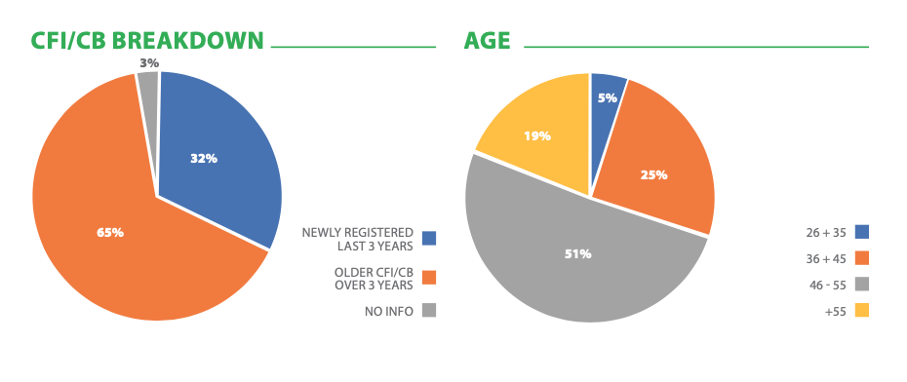
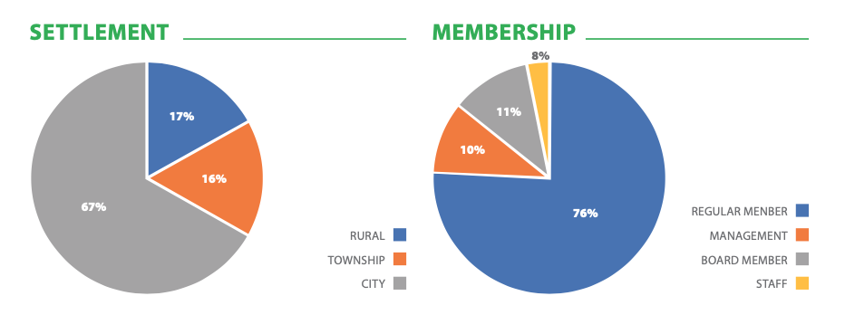
Member demographics (Quantitative)
add

Slide 7
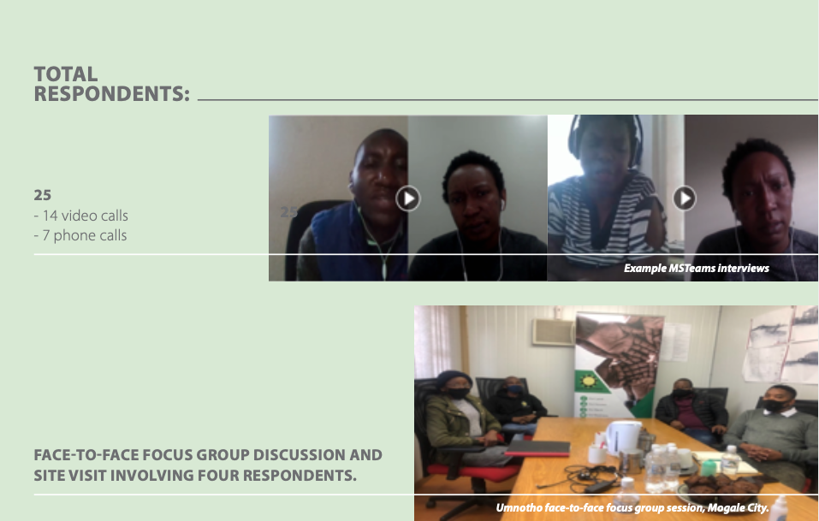
Member demographics (Qualitative)
add

Slide 8
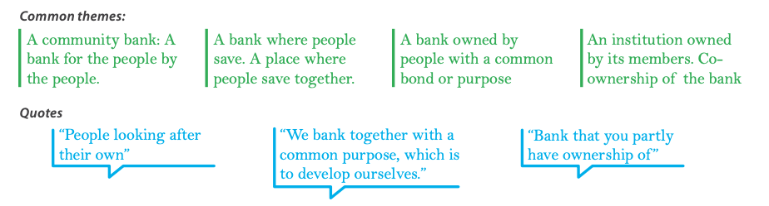
Defining a CFI/Cooperative bank
add
“It is people looking after their own.”

Slide 9
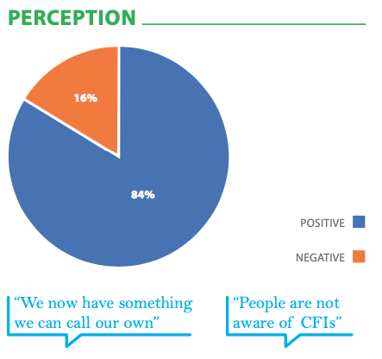
Perceptions of a CFI/Cooperative bank
add

Slide 10


Value proposition
add
QUESTION: Is there anything a CFI/CB offers that you cannot get anywhere else?

Slide 11
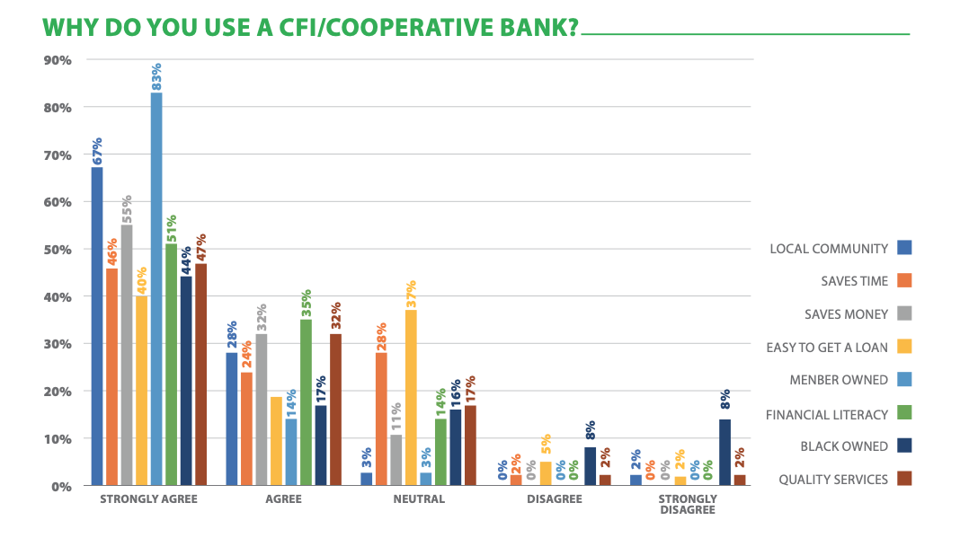
Value proposition
add
QUESTION: Why do you use a CFI/CB? (five-point scale)

Slide 12
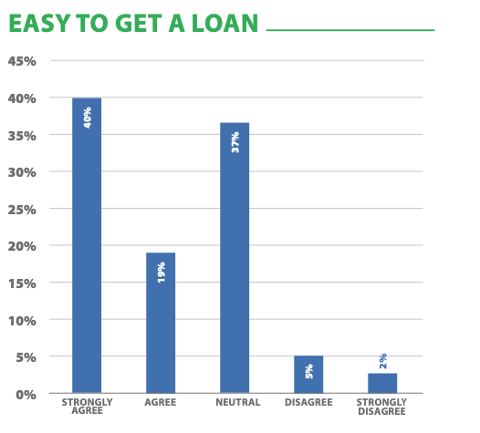
Value proposition
add
QUESTION: Is it easy to get a loan?

Slide 13
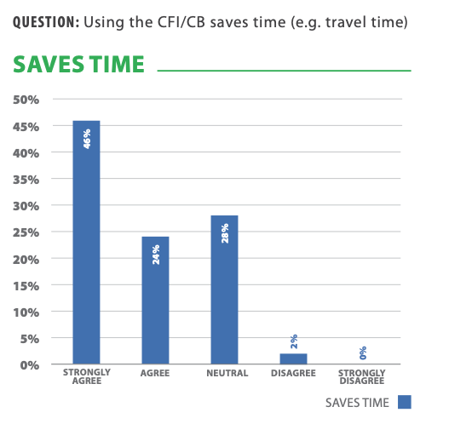
Value proposition
add

Slide 14
Value proposition
add

Slide 15
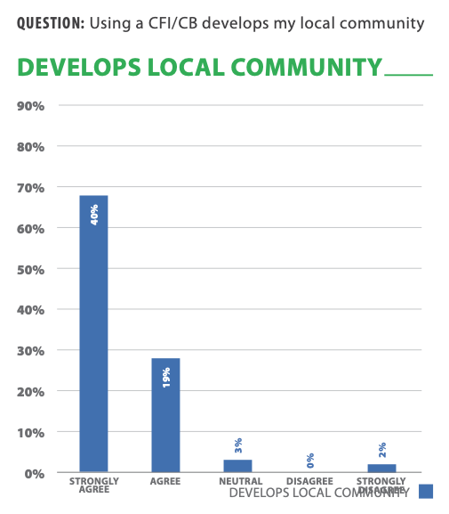
Value proposition
add

Slide 16
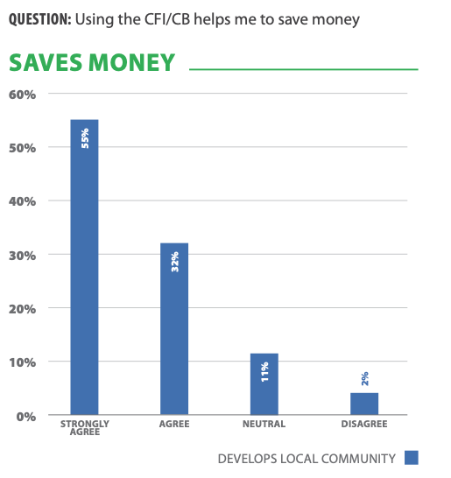
Value proposition
add

Slide 17
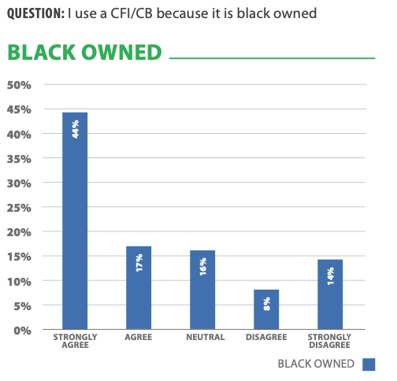
Value proposition
add

Slide 18
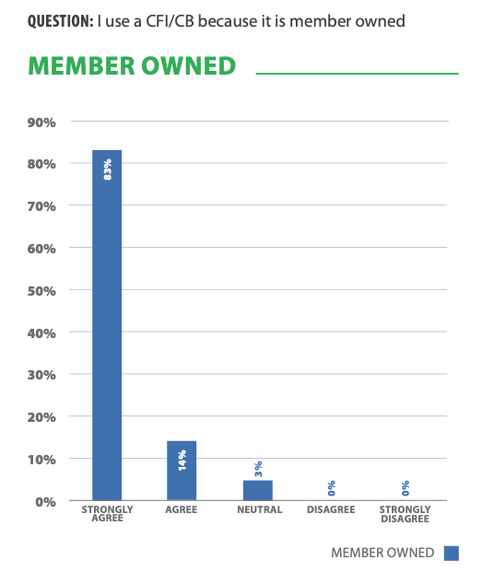
Value proposition
add

Slide 19
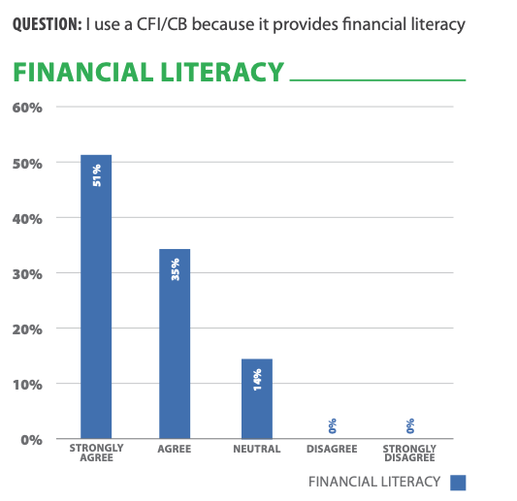
Value proposition
add

Slide 20
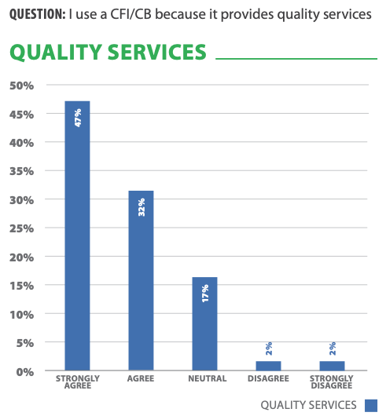
Value proposition
add

Slide 21
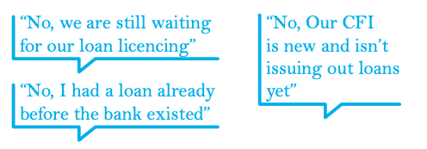
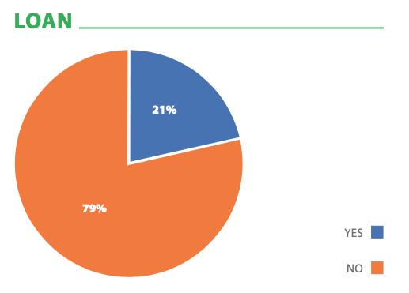
Challenges and opportunities (Loans and savings)
add
QUESTION: Do you have a loan from your CFI/CB?
Challenges
Opportunities

Slide 22
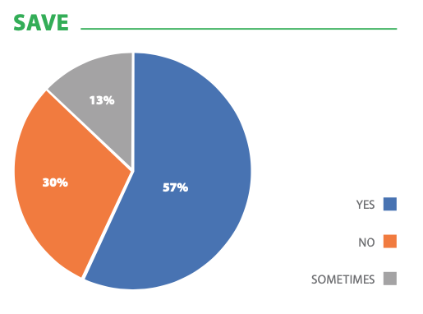
Challenges and opportunities (Loans and savings)
add
QUESTION: Are you currently saving with your CFI/CB?
Challenges
Opportunities

Slide 23


Other challenges and issues
add
Restrictive policies and licensing process
Lack of start-up resources and funds
Independence and capabilities
Differing ambitions between younger and older members
Lack of financial literacy and management experience
Targeting training better
Need for greater digitization

Slide 24
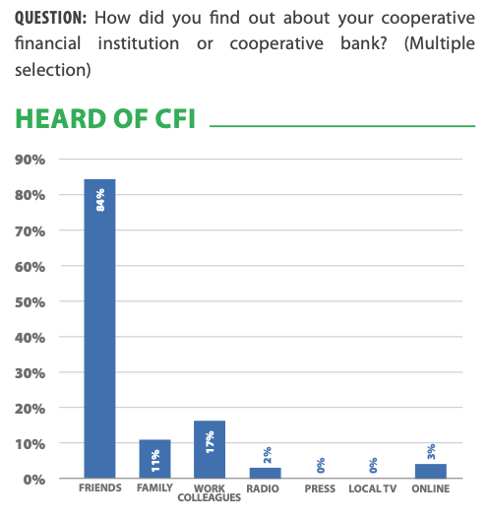
Opportunities for growth
add

Slide 25
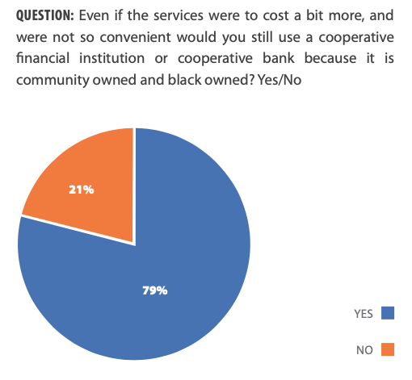
Opportunities for growth
add

Slide 26
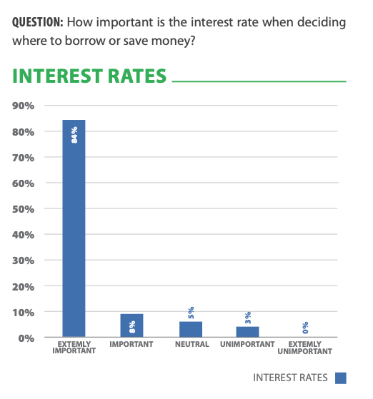
Opportunities for growth
add

Slide 27
Role of the CBDA
add
Members feel that the CBDA’s role is to help CFI/CBs prosper
CBDA has been of great help in educating and providing information for the sector however its role is still not clearly defined in the eyes of the CFI/CBs.
CDBA can help in making easing of policies of steering members to the right information sources

Slide 28
Complaints procedure
add
Members indicated that they trust their board members to deal with their claims procedure.
In scenarios where a claims procedure took place, the CFI/CB was able to handle them successfully without any further complaints.
There is some knowledge of the Financial Sector Conduct Authority (FSCA) among CFI/CB members, but some of them have not gone to it with complaints, but rather to their own institution’s board members.
Some members felt that an ombudsman for CFIs/ CBs would be valuable as they have experience with different complaint scenarios and situations.
Some members felt that it is a good initiative, but not practical, as the CFI industry is too small for an ombudsman.
Another respondent indicated that “the whole point of a CFI is for people to govern themselves”.
CFIs are people-focused, and an ombudsman might take away the humanity and trust that members have in their organisations.

Slide 29
THANK YOU

